Slide 1
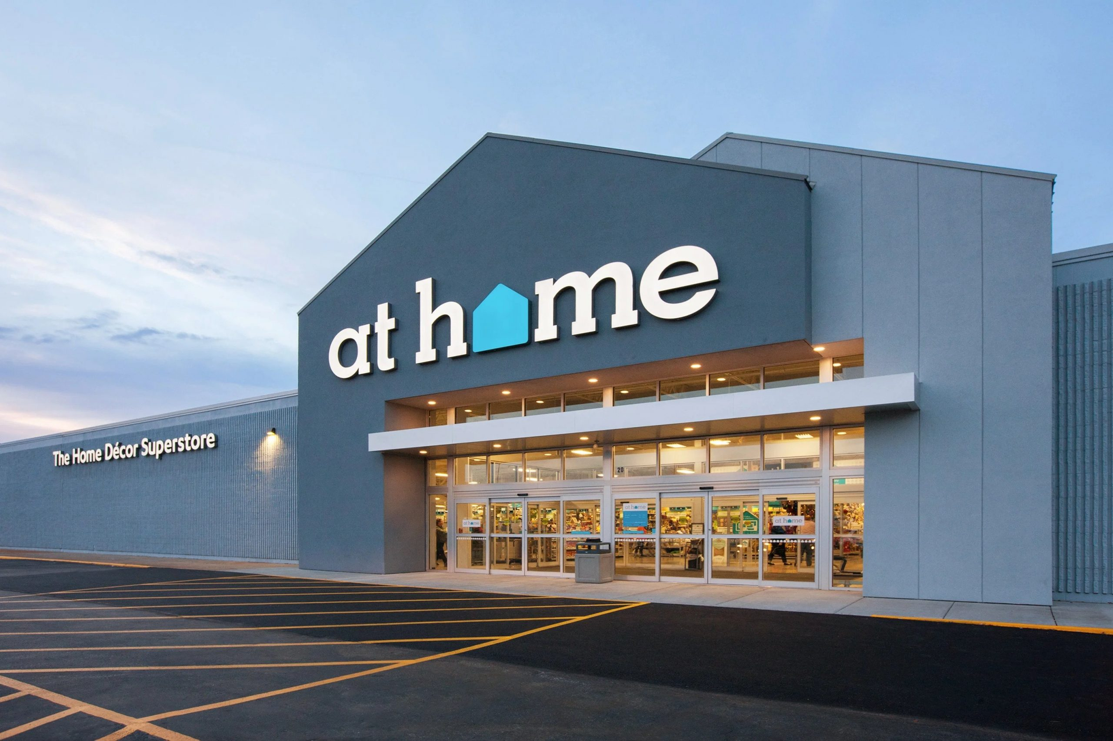
Team Capstone Project
SUBMITTED BY:
SHIVANI ADSAR

Slide 2
AGENDA
Introduction
Industry Analysis
Data Analysis
Business Recommendations
References

Slide 3
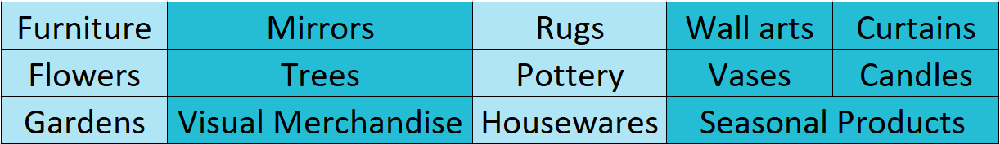
Introduction
At Home – A Retail Superstore Chain
More than 225 stores covering 40 states across
Full spectrum of home décor styles ranging from traditional to country, vintage and modern

Slide 4

Project Scope
Understanding the home décor sector, laying out some basic background questions from the data
Drawing analysis and extracting actionable insights
Providing recommendations to grow the store’s business
Products & Results
Costs
Goals
Tasks
Deadlines

Slide 5
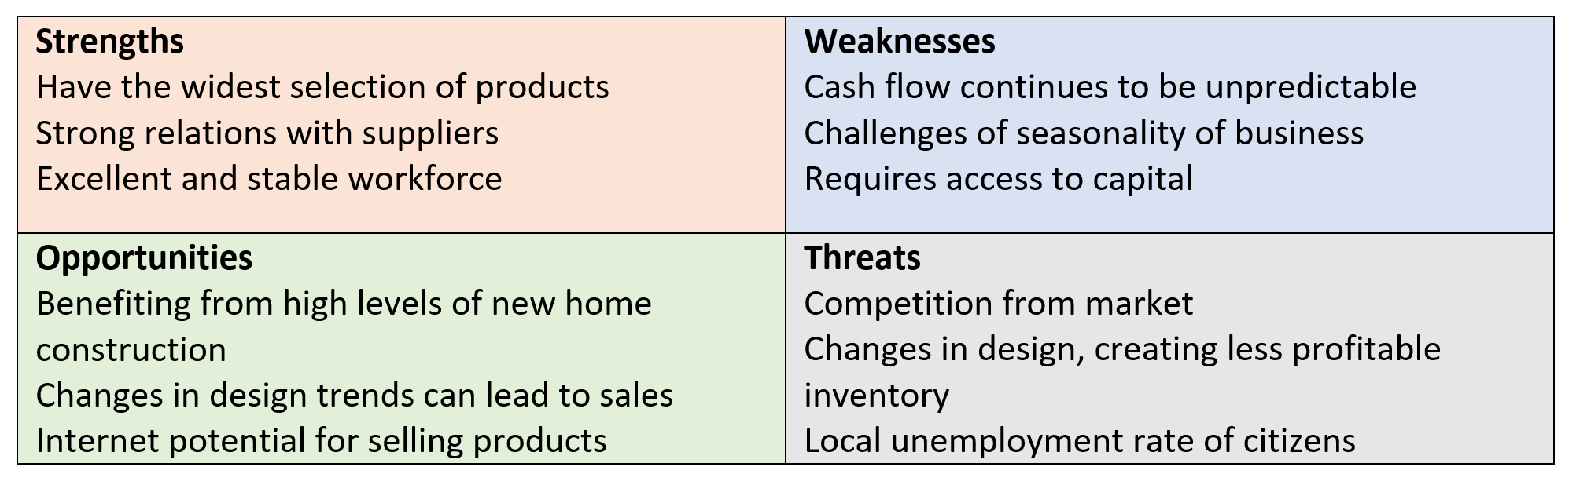
SWOT Analysis

Slide 6
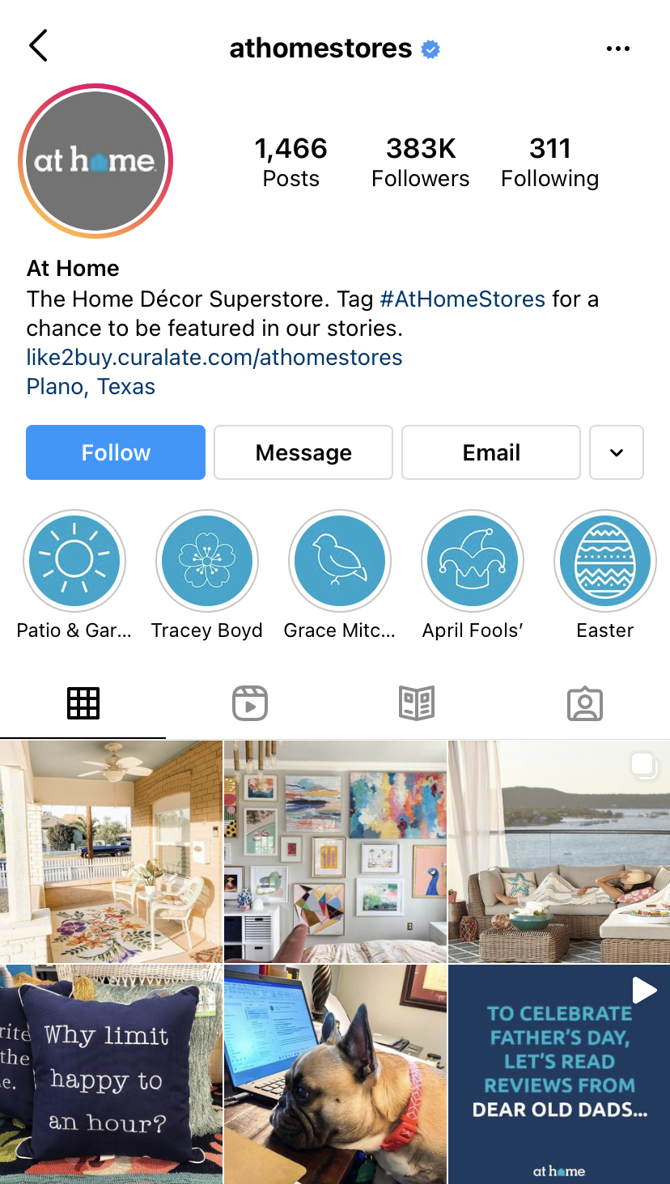
Company Analysis
Selling exclusive line of products
85% of its customer base comprises of women.
An email database of over 500 million addresses.
More than 400 new products arrive on the shelves weekly.
They have a potential to expand to 600 stores in long-term.
Enhance direct sourcing of the products to provide everyday lower prices.
Reward programs for continued loyalty, insider perks loyalty program for frequent shoppers and leveraging the IT to gain visibility in customer preferences and spending patterns.
Working closely with 500 vendors that includes 36% domestic and 65% international including vendors from India, China, Vietnam, Turkey and Hong Kong.
Social Media is used extensively for marketing & sales.

Slide 7
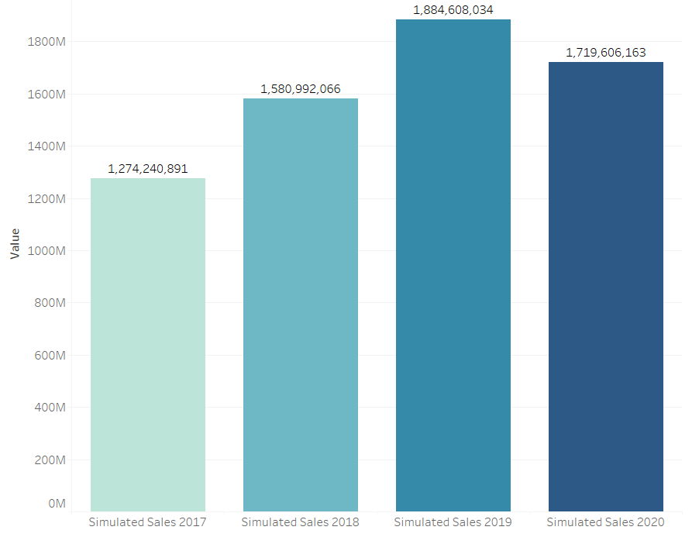
Catalyst
Sales increased for 3 consecutive years but decreased for year 2020 as the result of pandemic.
This gave us motivation to analyze At Home zip codes deeply to get meaningful insights

Slide 8

Business Questions
How is the competition around At Home stores?
For which stores the strategies can be revisited?
How pandemic impacted the AHG?
Which states has scope for new stores?
How demographics like total population or median income, race/ethnicity can impact the sales and future strategies?

Slide 9

Data Analysis
We divided our analysis into following categories -
Demographic Impact Analysis
Potential Customer Analysis
Spending Scope Analysis
Competition/Store – Sales Analysis
Strategy Analysis

Slide 10
Demographic Impact Analysis

Slide 11
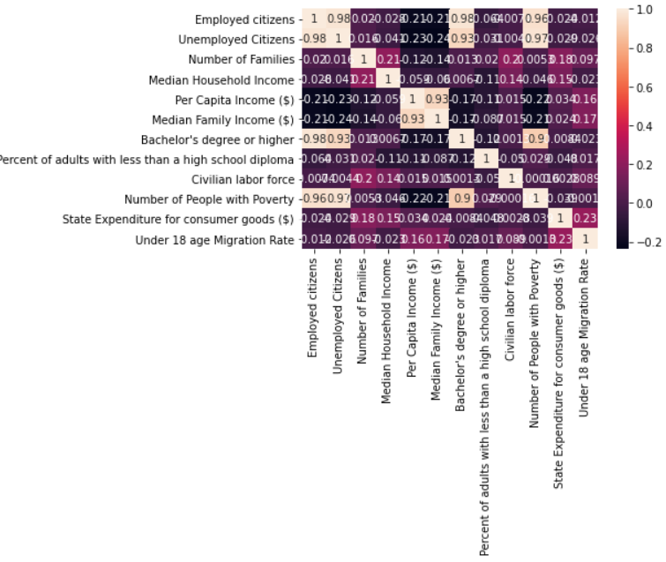
Correlation Matrix
The correlation matrix helped in deciding data combinations and variable dependencies.

Slide 12
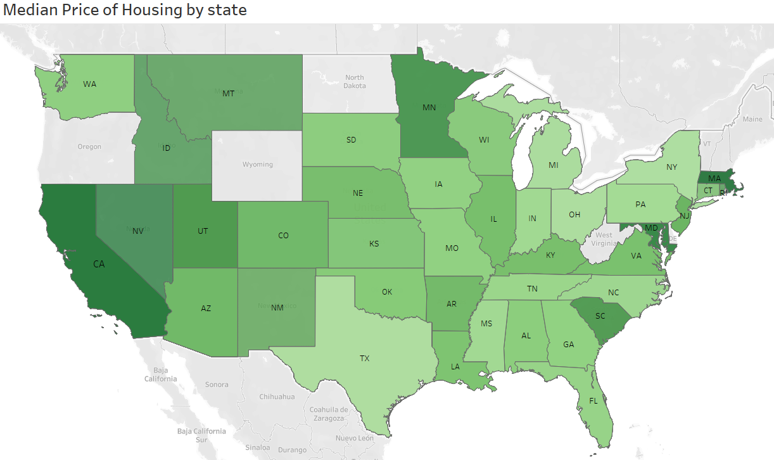
Housing Price
Observations:
Massachusetts has the highest median price of housing followed by California, whereas Missouri has the lowest price of housing

Slide 13
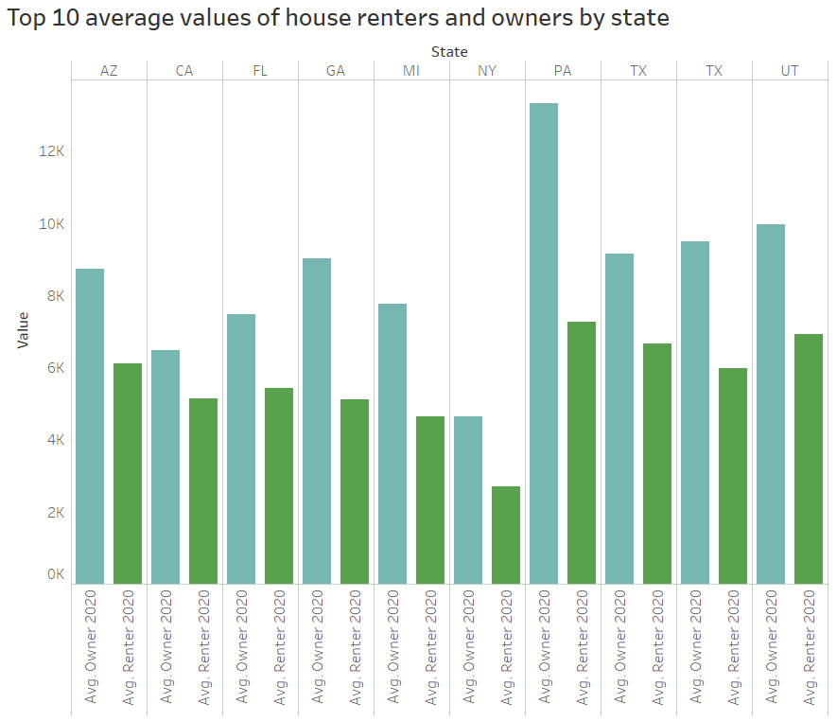
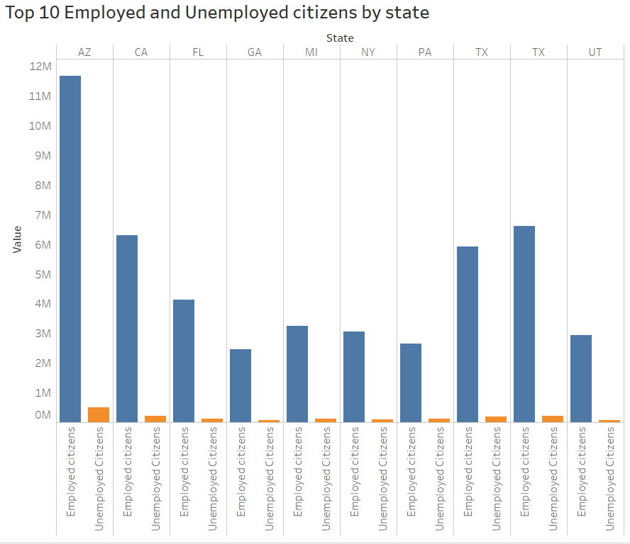
Housing & Employment
Observations:
Pennsylvania has highest number of average owners and renters, whereas New York has the least number of owners and renters
Observations:
Arizona has the highest number of employed and unemployed citizens, whereas Georgia has the lowest number of unemployed and employed citizens

Slide 14
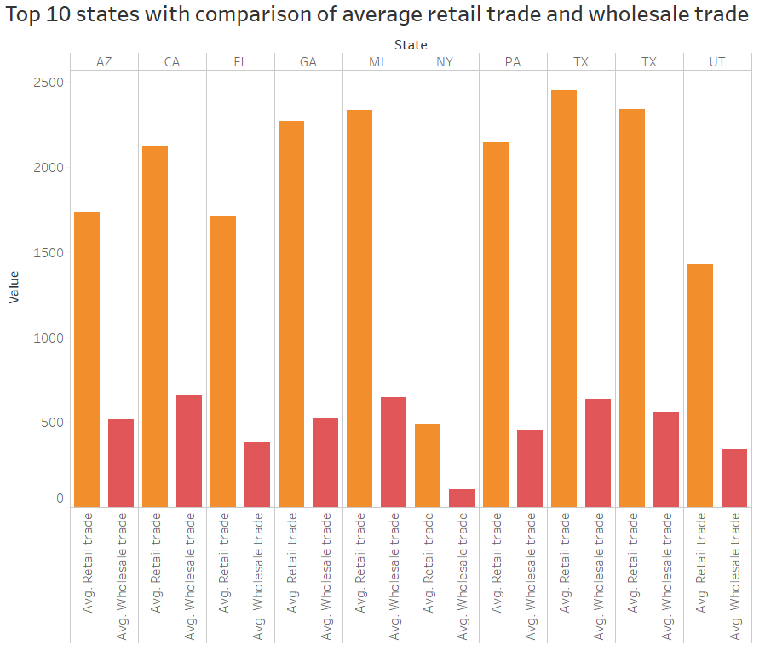
State wise Average Trade Comparison
Observations:
Texas has the highest average retail trade whereas California has the highest average wholesale trade.
However, New York has the least average retail and wholesale trade.

Slide 15
Potential Customer Analysis

Slide 16
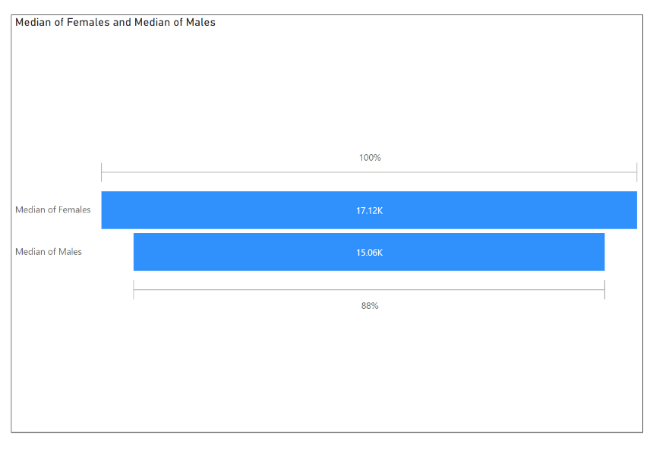
Gender Distribution
Median Values-
Female- 17.12K
Male- 15.06K
Reason for choosing median values is Outliers do not affect the median as strongly as they do the mean. Also, Median measure considers every value in the column Variable.

Slide 17
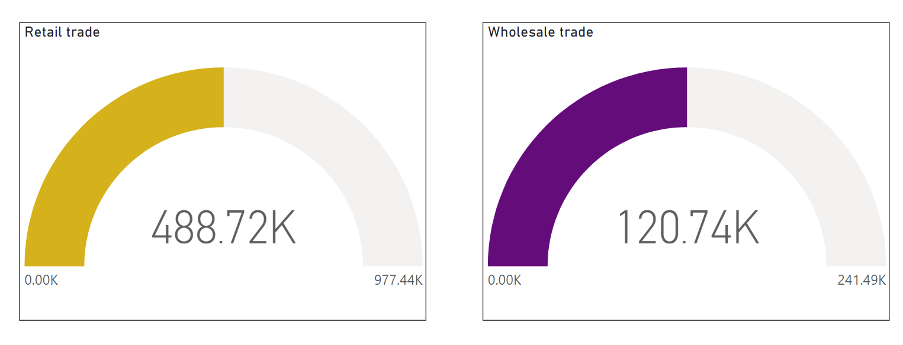
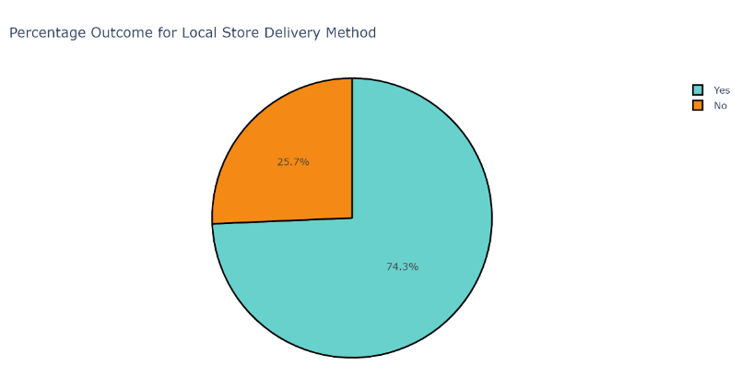
Trade Comparison & Store Delivery
From the graphs it is visible that retail trade is higher compared to wholesale trade which means the profit margin for the company is high.
But on the other hand, investment capital is low.

Slide 18
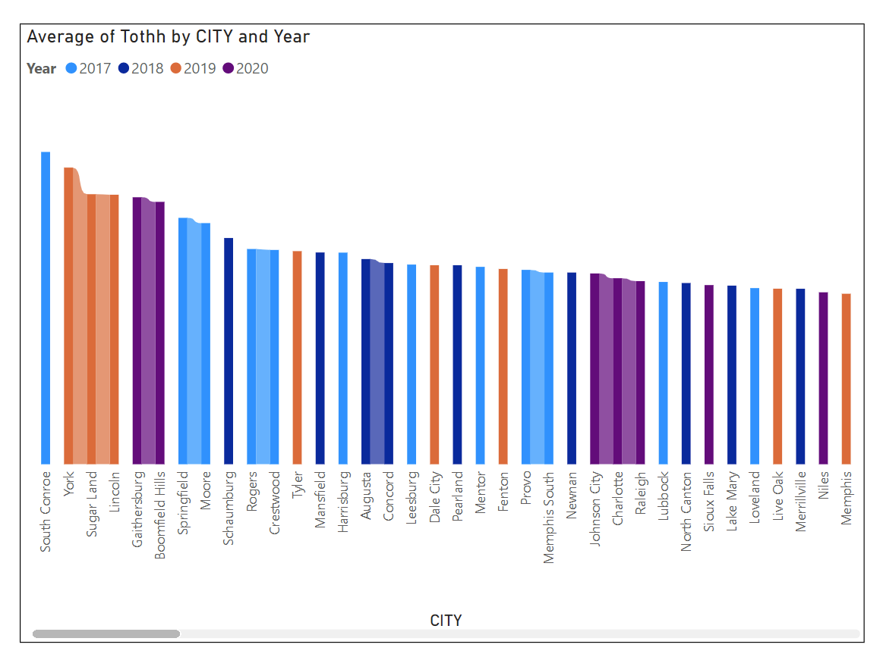
Total Household Year wise
The graph shows total number of households are being depicted for the years 2017 to 2020 ranked by city.
Ribbon charts are effective at showing rank change with the highest value always displayed on top for each time period.

Slide 19
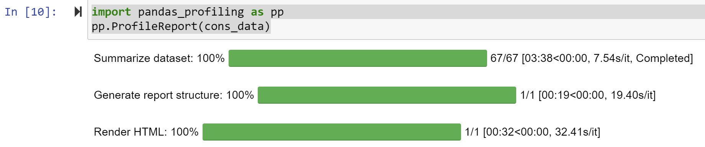
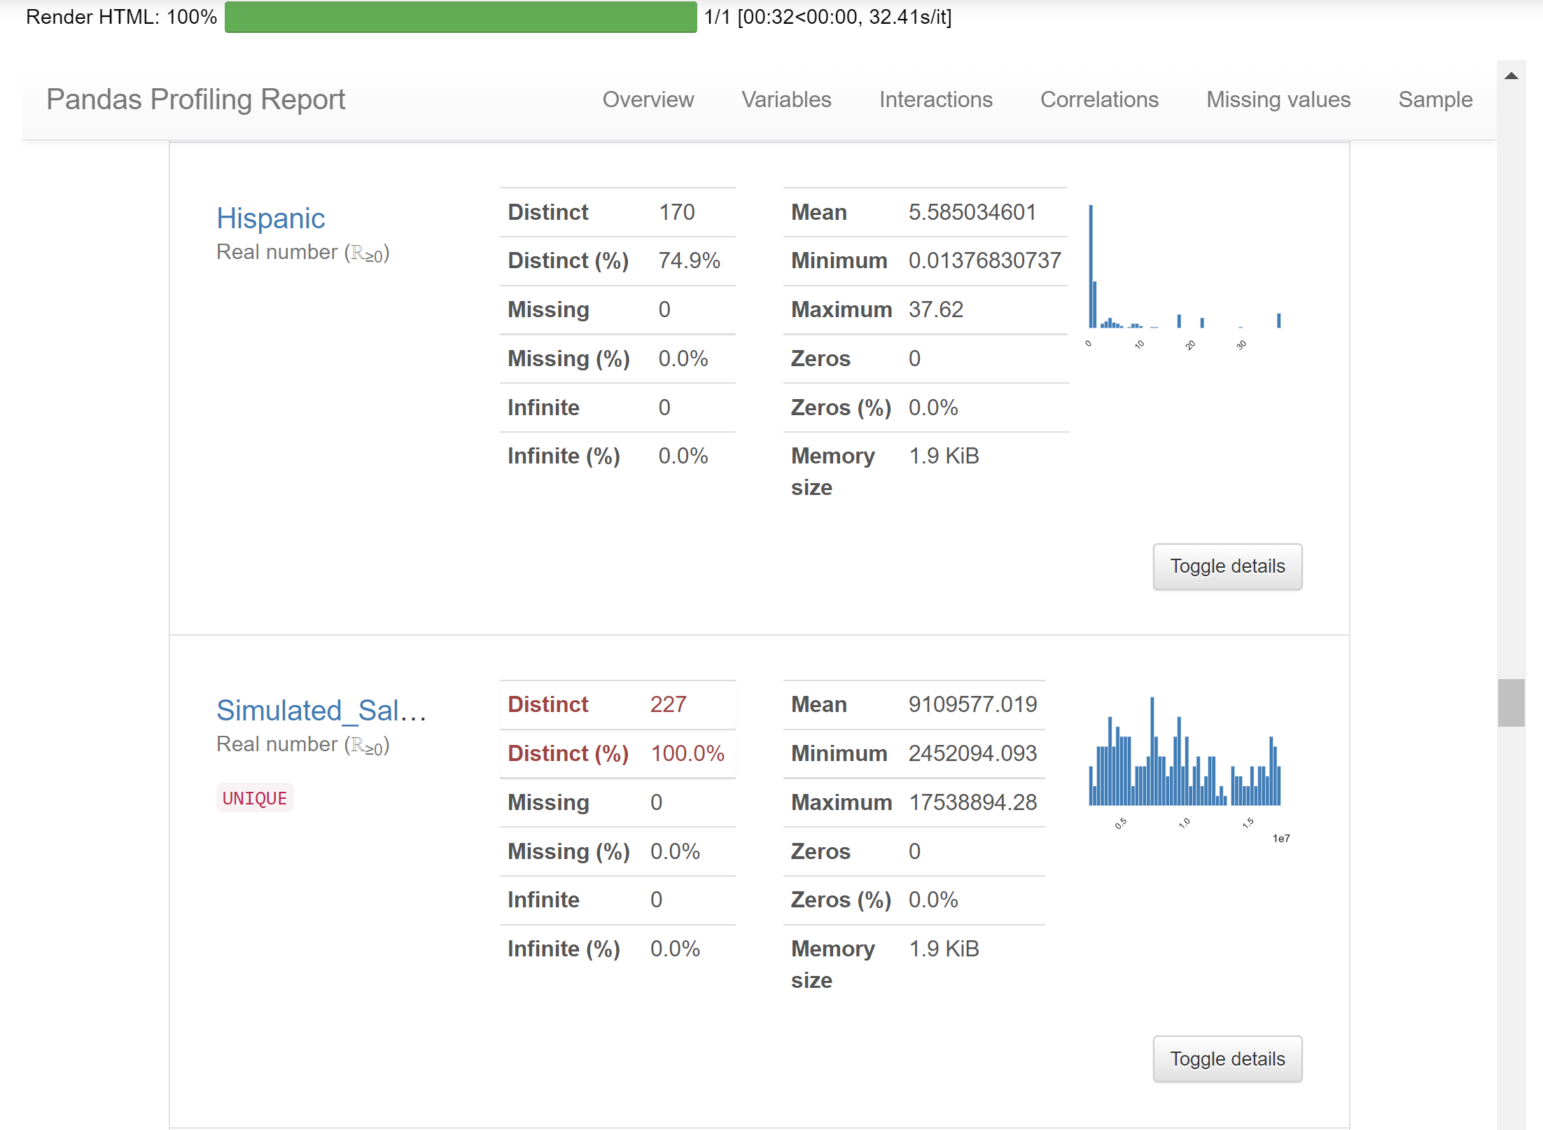
Python – Pandas Profiling Report
Pandas Profiling report is an interactive HTML report to detect every column’s deeper analysis, check on extreme/missing values, find relations and interactions between variables, correlations, and a summary of all the statistics.
This is a representation for Simulated Sales as it is the most important variable of our dataset.

Slide 20
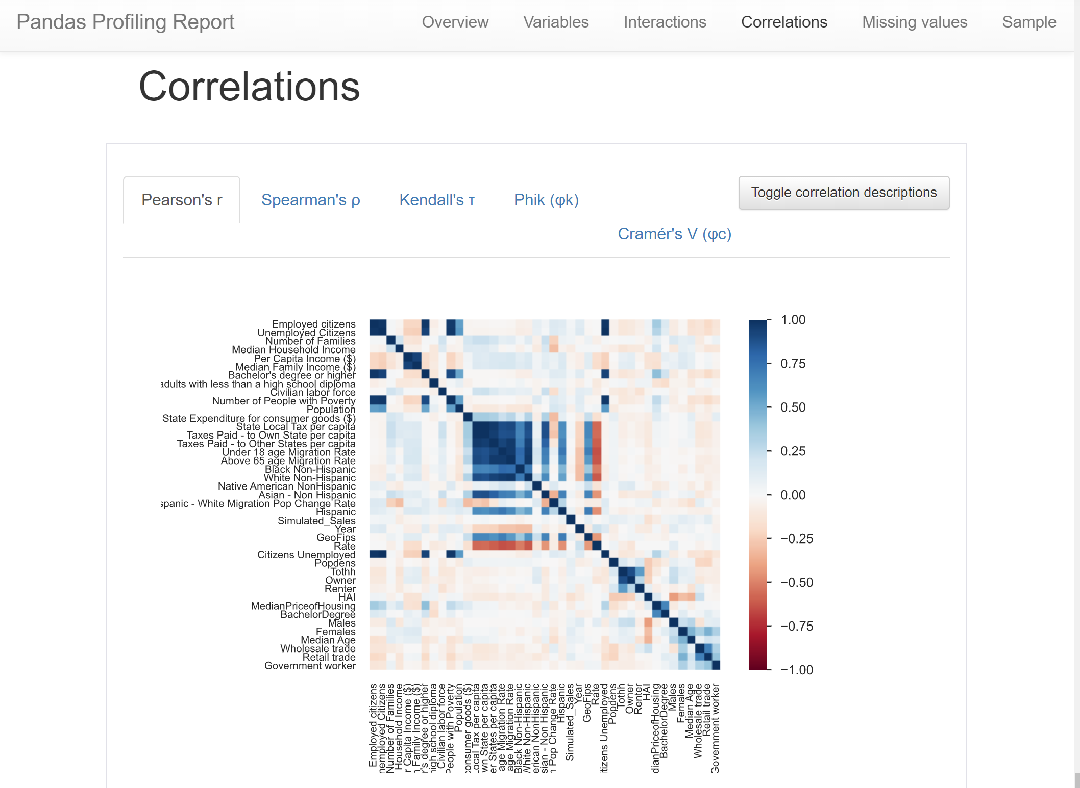
Python – Correlation Matrix
An additional feature within this report is the amazing Correlation matrix for not just one but 5 different hypothesis tests.
Pearson’s r
Spearman’s ρ
Kendall’s τ
Phik (φk)
Cramer’s V (φc)

Slide 21
Spending-Scope Analysis

Slide 22
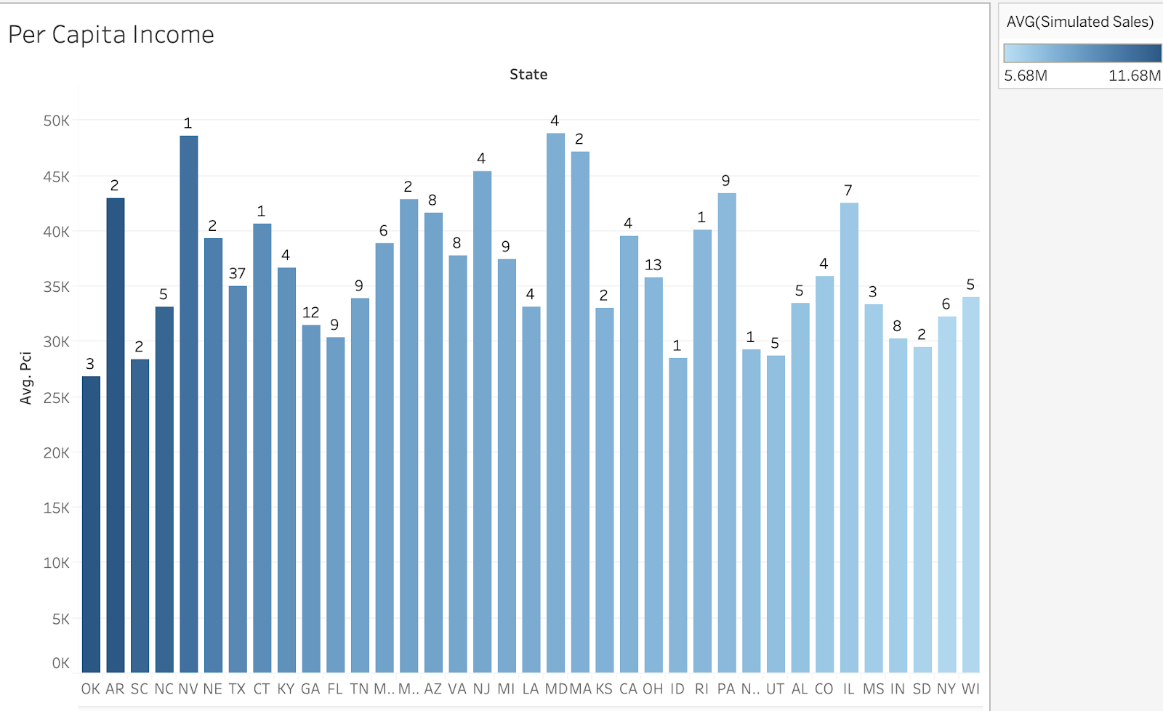
Per Capita Income
Shows the related average per capita income with each state’s average simulated sales.
The number of stores for each state shown on top of each bar.
Arkansas and Nevada can be potential states to open new stores because they have relatively high average PCI and average sales, but only 1 or 2 stores opened in these two states.

Slide 23
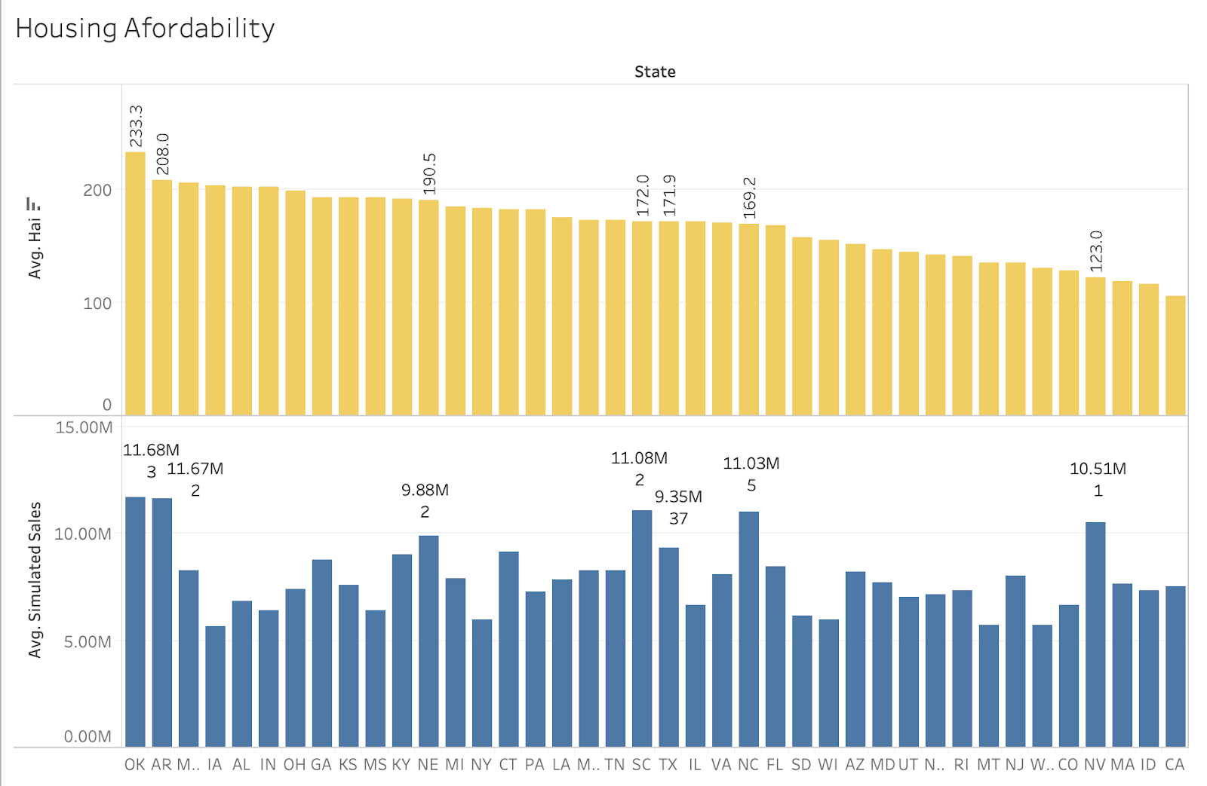
Housing Affordability
Shows the average housing affordability index and average sales for each state.
Oklahoma and Arkansas have the greatest potential to open new store because their HAI are higher than Texas, but fewer stores are opened in these two states compared with Texas.

Slide 24
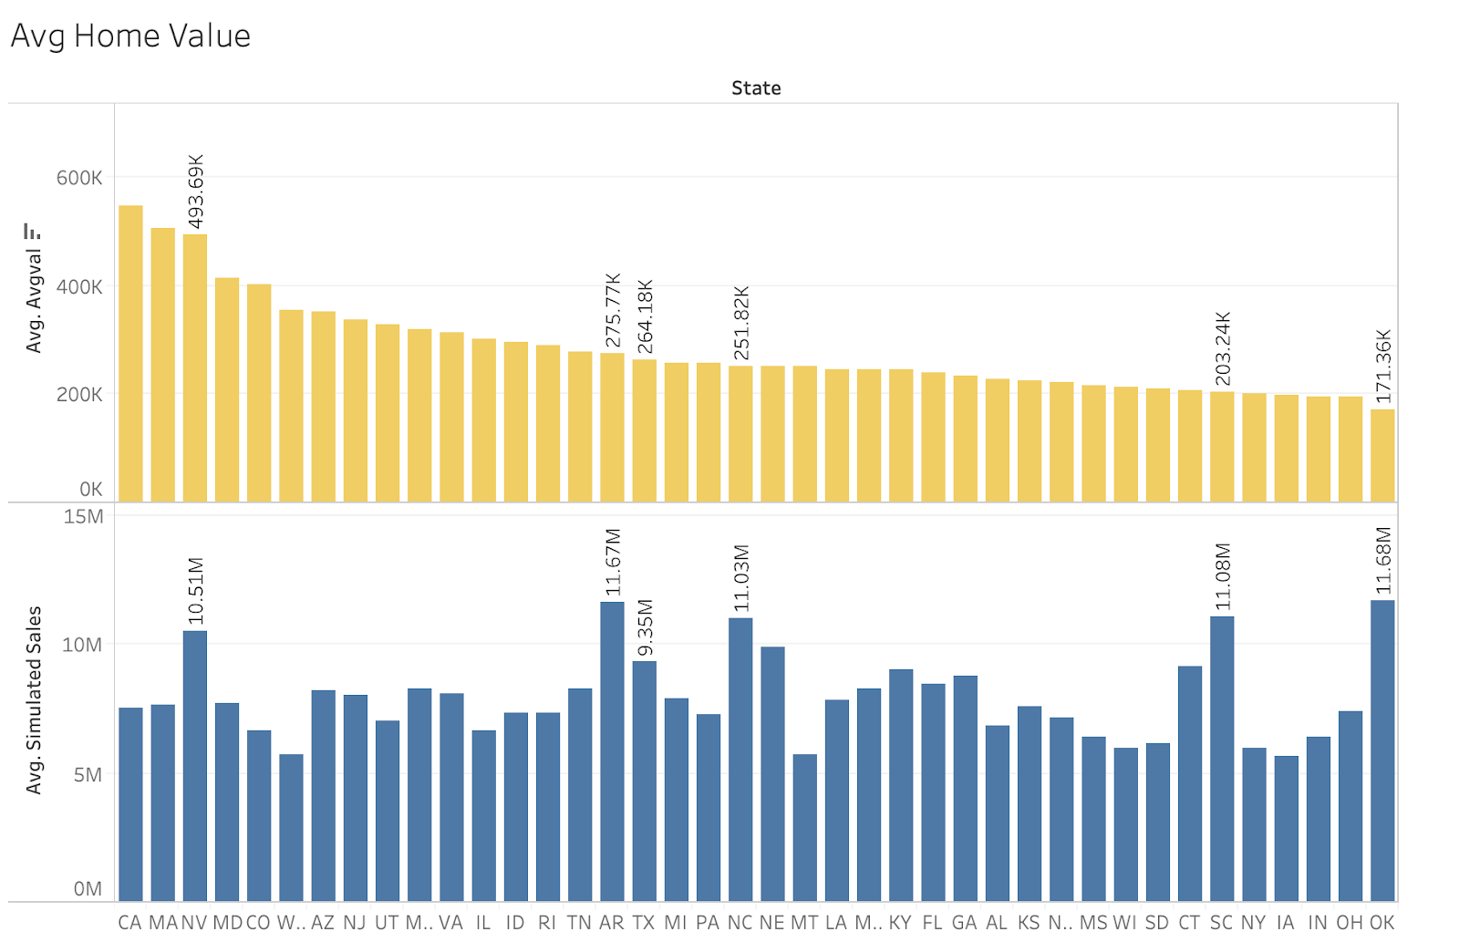
Average Home Value
Nevada and Arkansas have higher average home value and average sales. Higher home value indicates that people are more willing to spend for their houses. Thus, Nevada and Arkansas can be candidates for opening new stores.

Slide 25
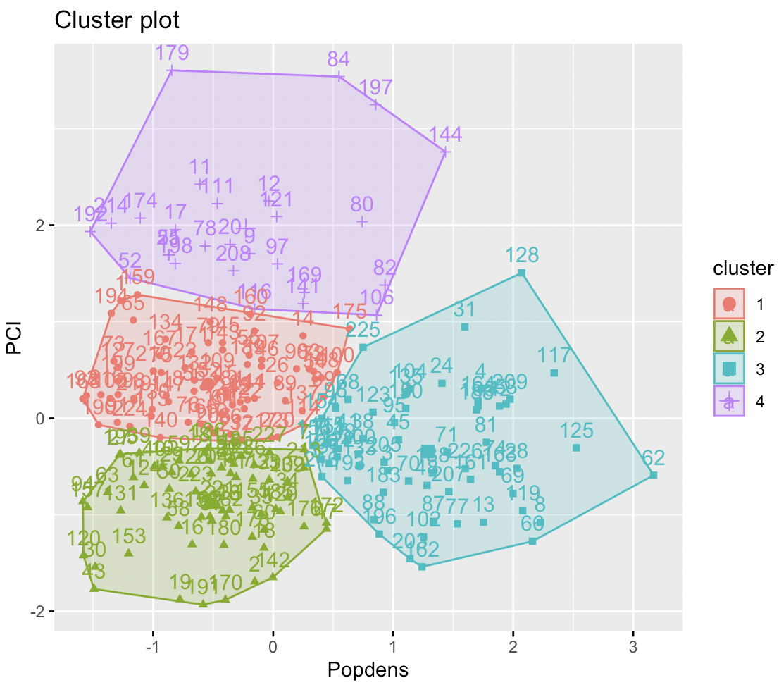
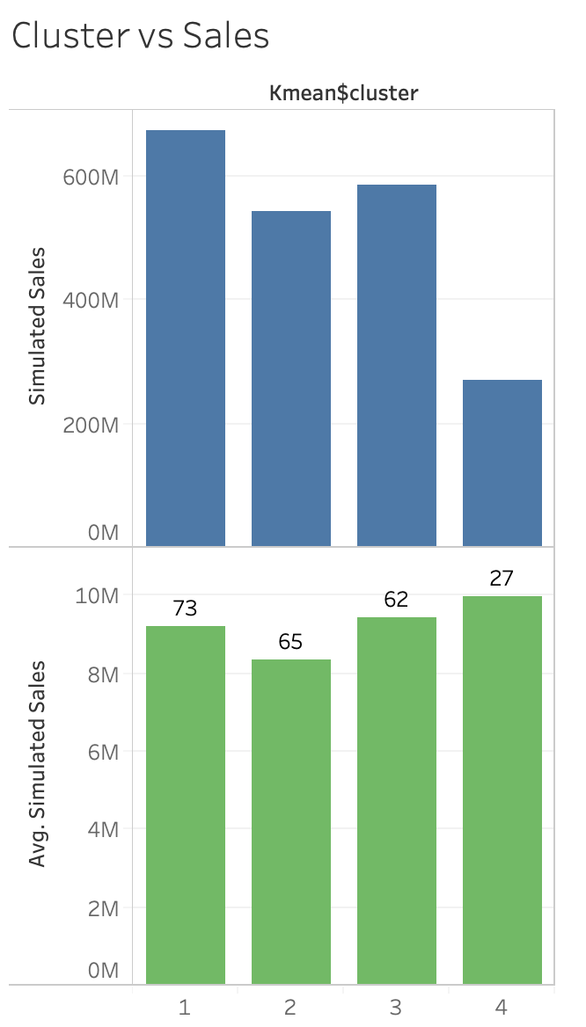
Kmean-Combined Factor

Slide 26
Competitive & Store-Sales Analysis

Slide 27
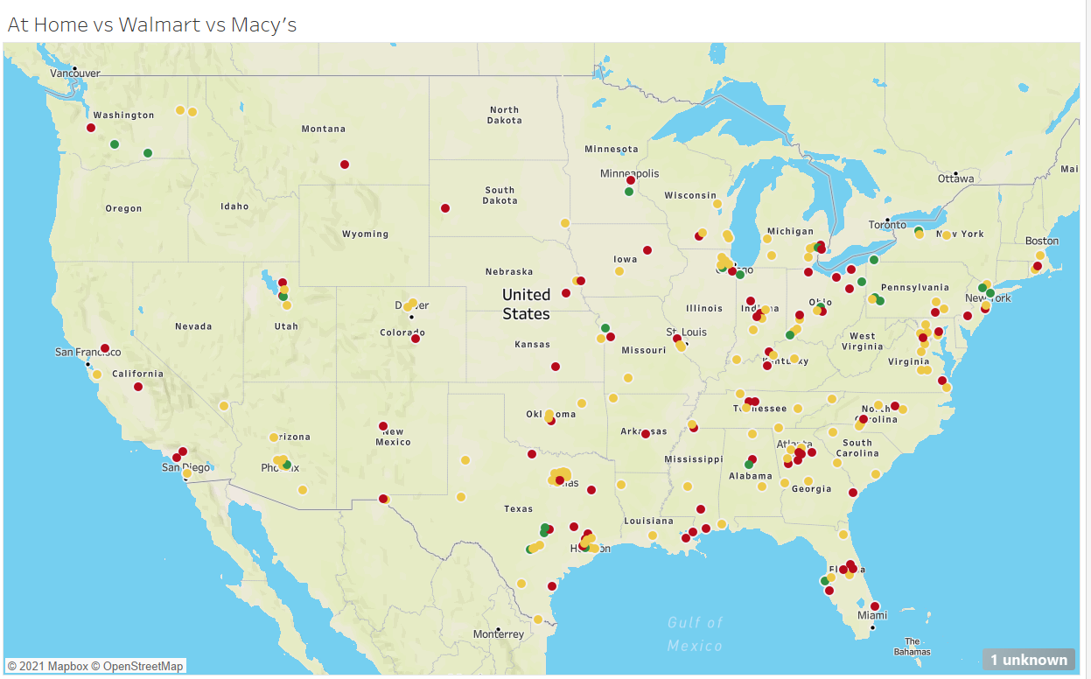
Arizona & Nevada has no Walmart or Macy’s nearby, thus giving an upper hand in retail stores.
Louisiana again is an state with potential for opening a new store.
For the states like Florida, Virginia, Ohio, Pennsylvania where At Home stores are in considerable distance with Walmart, the business can think of introducing low cost, variety home décor products than Walmart.
For New York, business can have more office décor products or customized products to suit the corporate lifestyle.

Slide 28
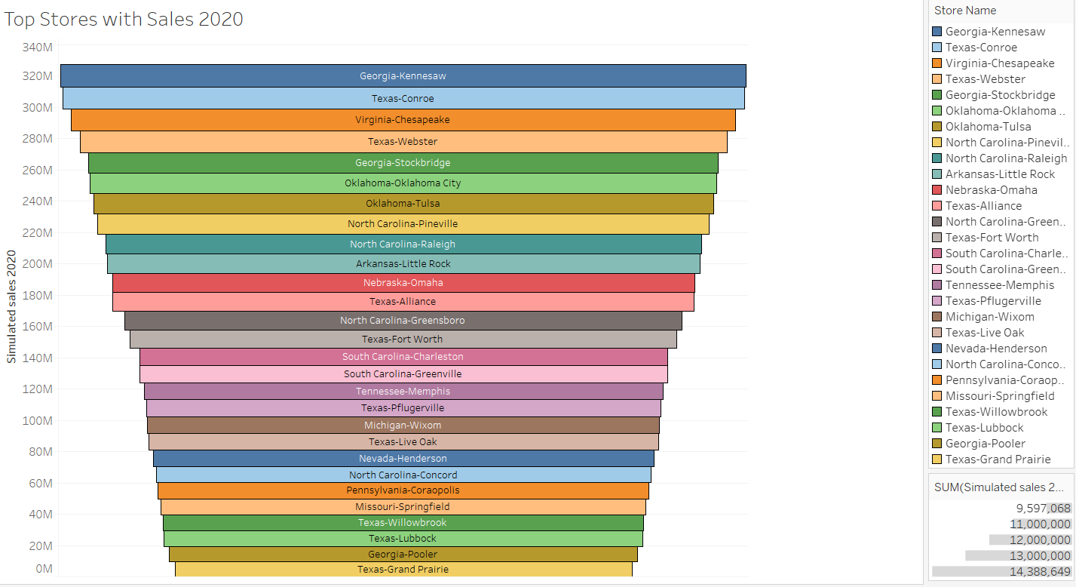
Georgia – Kennesaw [zip code - 30144] contributed the most towards the total sales in 2020.
It provides all the 3 services like ‘pickup in store’, ‘curbside pickup’ & ‘local store delivery’.
The same trend follows for the next 9 stores in line and ahead.
Starting with the local store delivery options can proved to be an effective strategy for other stores like Arkansas - Little Rock.

Slide 29
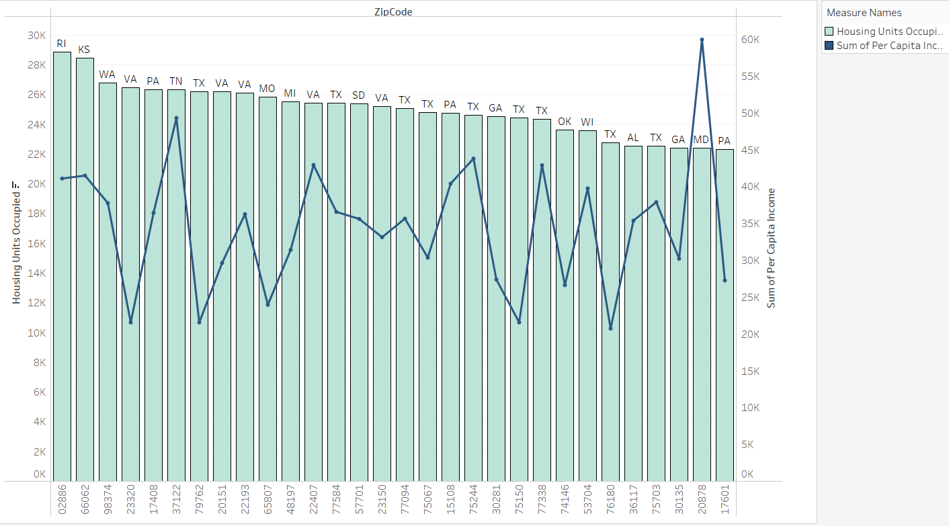
More than 90% of housing units are occupied.
Study shows more people moved into the houses than before.
States with less income but majority of units occupied can adopt strategies to introduce low-costs, budget products.

Slide 30
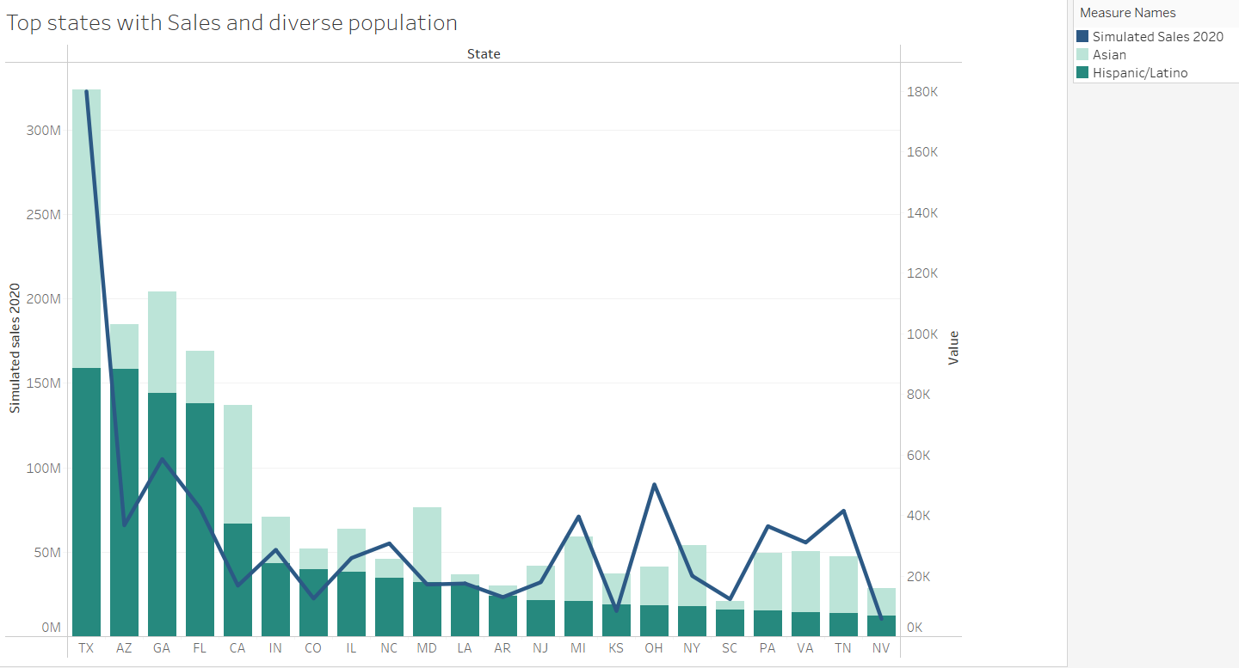
Texas has highest number of Hispanic/Lationo as well as Asian population.
Recent study shows these races will gradually increase over the years.
AZ, GA, FL has more Hispanic/Latino concentration.
States like New York (NY), Pennsylvania (PA), Virginia (VA) and Tennessee (TN), Maryland (MD) have more Asian concentration and thus AHG in those clusters can think of working on the line of products that matches Asian taste.

Slide 31
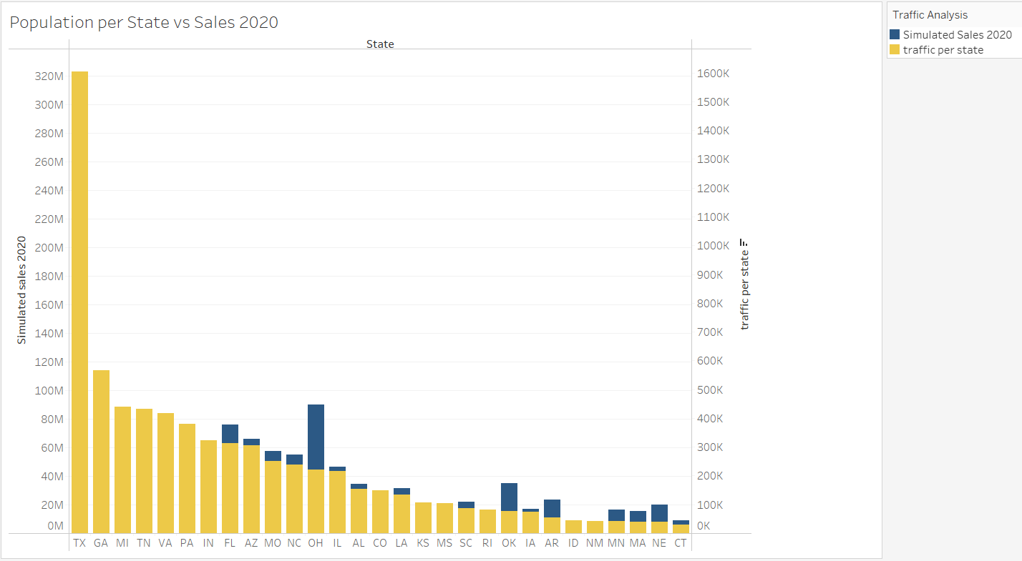
Texas, Georgia, Michigan, Tennessee, Virginia, Pennsylvania have generated equal number of sales w.r.t to the population 2020.
Ohio, Oklahoma has biggest scope to open a new store where sales generated > population.

Slide 32
Strategy Analysis

Slide 33
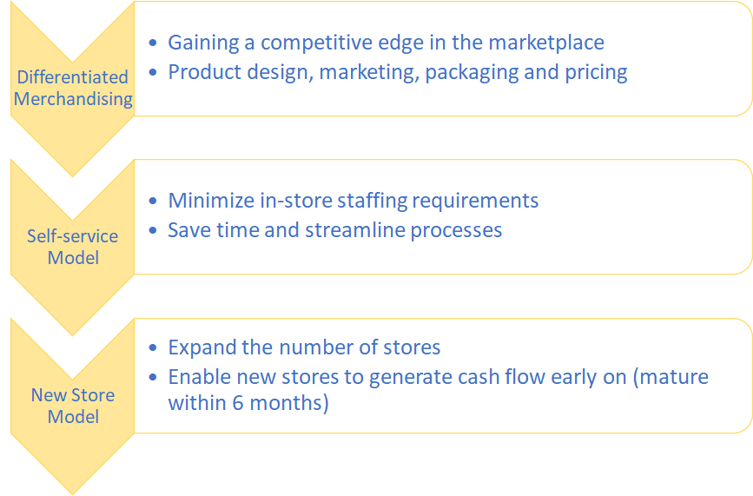
Current Strategy

Slide 34
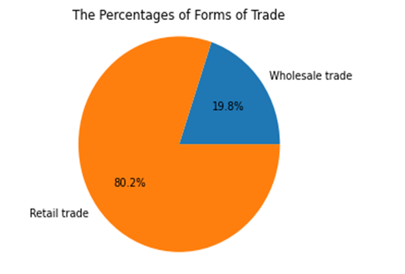
The forms of Trade
The main trade mode of At Home Group is Retail Trade
At Home Group's main form of trade is selling goods to consumers in small quantities for personal use, rather than for resale or commercial use.

Slide 35
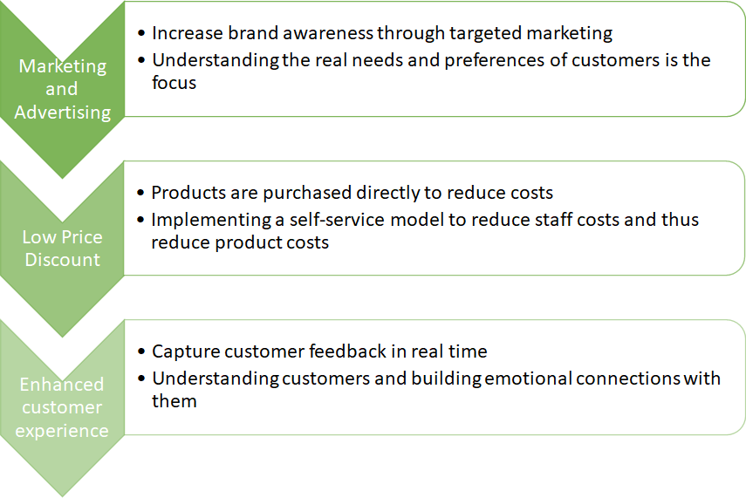
Strategic Plan

Slide 36
Business Recommendations
Spending Recommendations
Arkansas can be the state with greatest potential to open new store because of relatively high PCI, HAI, and home value compared with Texas. Arkansas also has only two stores with high average sales compared with Texas.
AHG also need to focus on the area with characteristics of high PCI and low population density because the Kmean clustering analysis suggests that this kind of area has higher average sales and only 27 stores opened compared with other areas with over 200 stores.
Customer Recommendations
Statistics proved that the retail home furnishing sales declined by 21% due to pandemic and thus, At Home must think of introducing “home delivery” service especially for the metros.
Pandemic has changed the way people use to shop and statistics showed that Amazon & Wayfair hold the biggest share in home furnishings/décor market and thus At Home must also think of introducing an ecommerce website keeping in mind the customers preferences, current and future market trends.
Trends have shown that ethnicity affects the sales and thus it becomes very important to attract and retain every race by introducing products that matches their taste and likings. States with heavy concentration of Asians should lure them by importing more products from India & China or introducing more ethnic products.
Demographic Recommendations
Texas has the highest average retail trade whereas California has the highest average wholesale trade. This will help the At Home store management in deciding the states to be targeted for opening new stores based on the retail and wholesale trades of those locations.
Pennsylvania has highest number of average owners and renters, whereas New York has the least number of owners and renters. This analysis will help the store in understanding the number of renters and owners, which benefit the store management in planning out the products and stores at various locations.

Slide 37
References
[1] Rajagopal, Pitt, Michael, & Price, Samantha. (2010). Measuring sales performance of home décor products. Journal of Retail & Leisure Property, 9(2), 105–124. https://doi.org/10.1057/rlp.2009.25.
The study in this paper revels balance in all the sales activities and how those affect the overall performance of an organization. Moreover, it emphasizes effectiveness depends on amount and quality of information getting generated within a business. Monitoring and control of the sales tasks must include negotiating, prospecting & qualifying, delivery method, approach, and problem-solving demo-able solution.
[2] Bumblauskas, D., Nold, H., Bumblauskas, P., & Igou, A. (2017). Big data analytics: transforming data to action. Business Process Management Journal.
This paper deals with an amalgamation of theoretical processes for operations and managers in order to collect, analyze & respond upon the data conquered extracted from the large datasets. An example of a case study with a dashboard further epitomizes quality of data and context of data binge.
[3] Adler, J., & Safari, an O'Reilly Media Company. (2016). Data Governance (1st edition).
A business-driven initiative for overview and trends of data governance. Role of IT as a critical role. Also, a high-level model has been introduced in the segment for efficient communication and responsibilities in the data success.

Slide 38

Thank You
Any Questions

